Slide 1
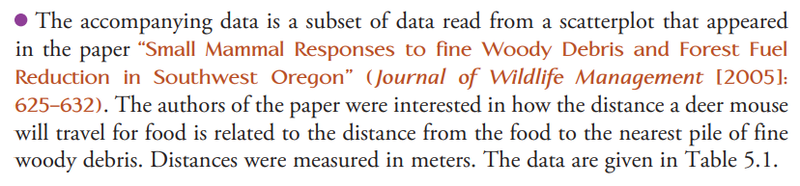
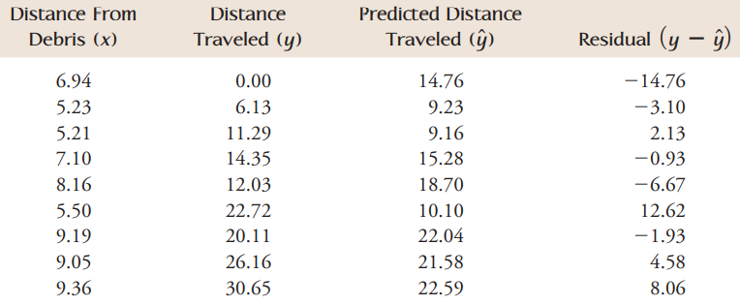
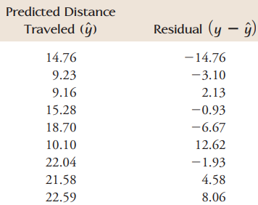

Slide 2

Residuals, $R^{2}$, S
- Lesson 3.3 -

Slide 3
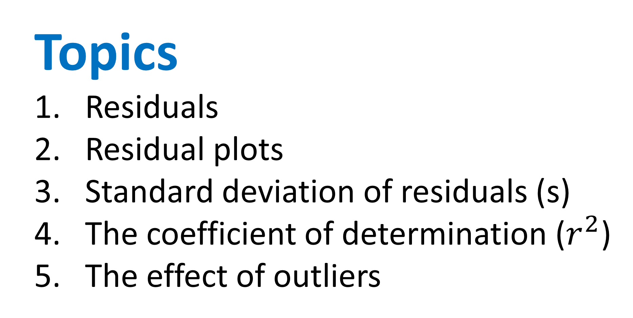
Topics
Residuals
Residual plots
Standard deviation of residuals (s)
The coefficient of determination ($r^{2}$)
The effect of outliers

Slide 4
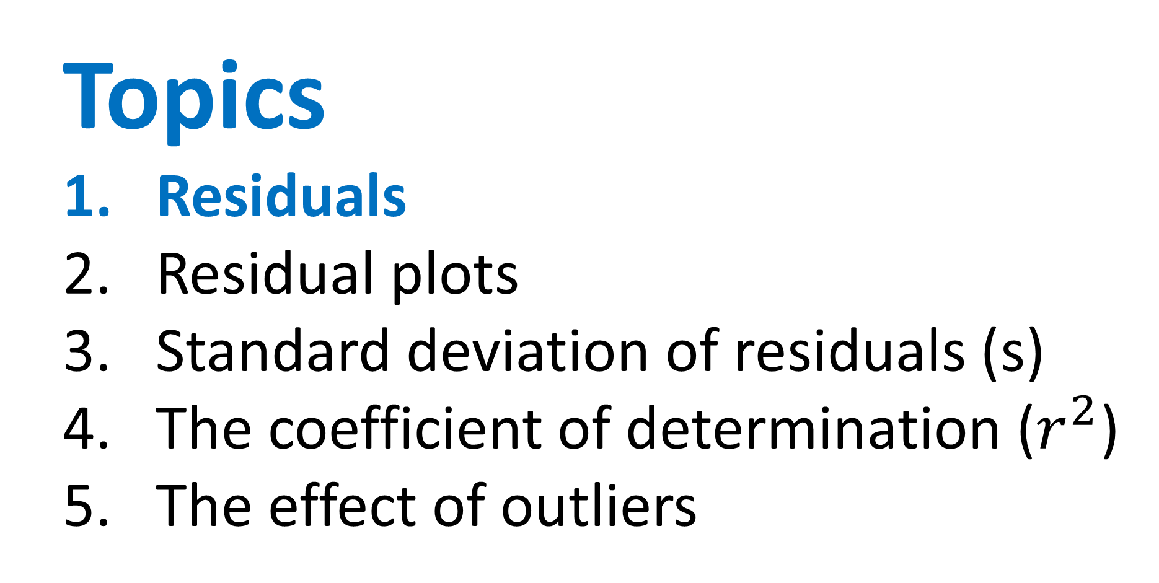
Topics
Residuals
Residual plots
Standard deviation of residuals (s)
The coefficient of determination ($r^{2}$)
The effect of outliers

Slide 5
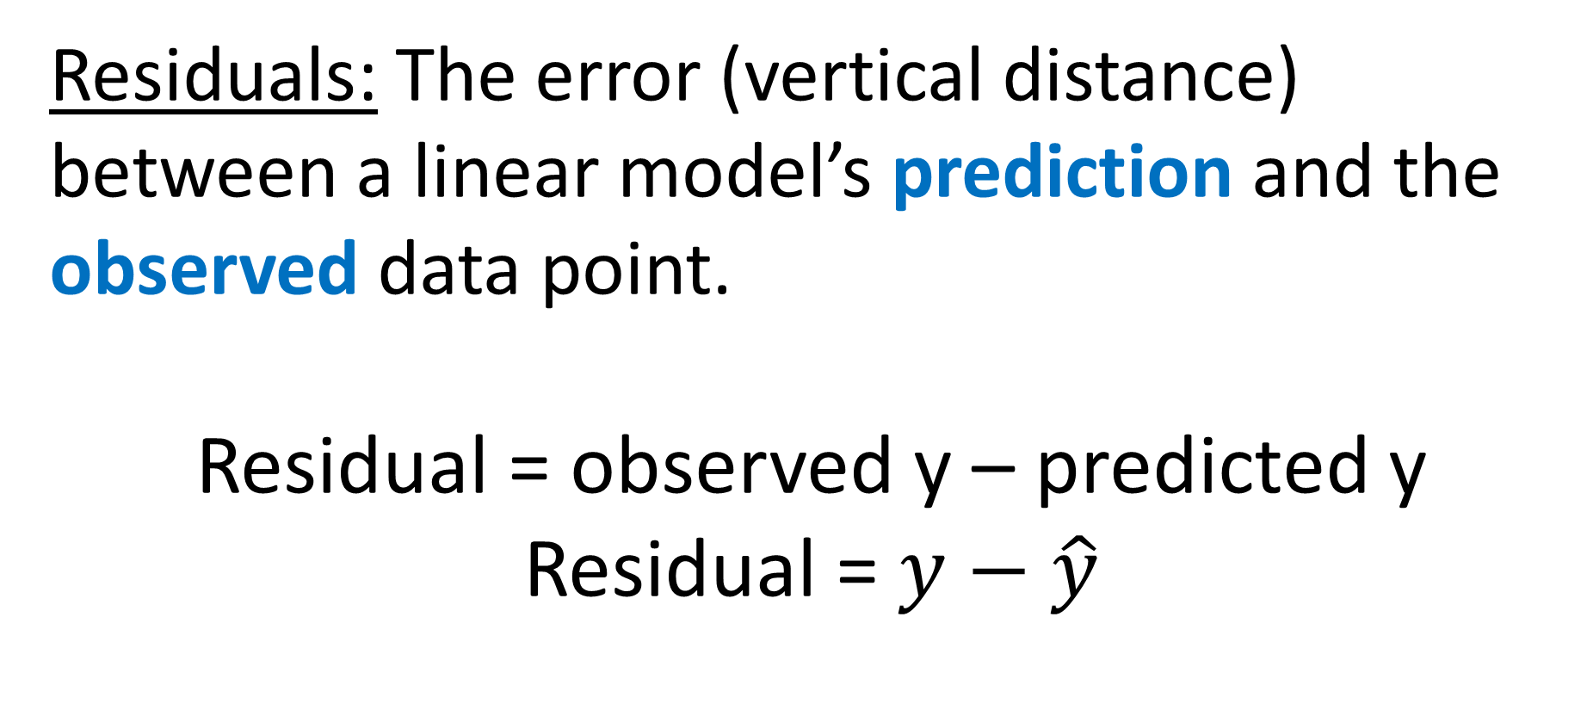
Residuals
Residuals: The error (vertical distance) between a linear model’s prediction and the observed data point.
Residual = observed y – predicted y
Residual = $y−\hat{y}$

Slide 6
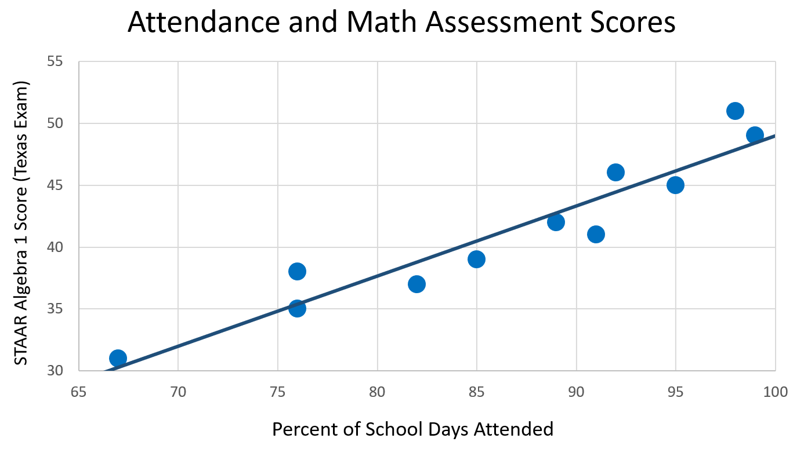

Slide 7
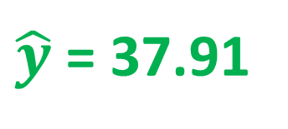
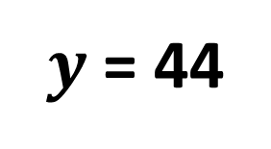
The student gets 44 questions correct on his exam. Find and interpret our model’s prediction error (residual) for this student.
$y$ = 44
6.09
$\hat{y}$ = 37.91

Slide 8
The actual test score is greater than predicted by 6.09 points.
$y$ = 44
6.09
$\hat{y}$ = 37.91

Slide 9
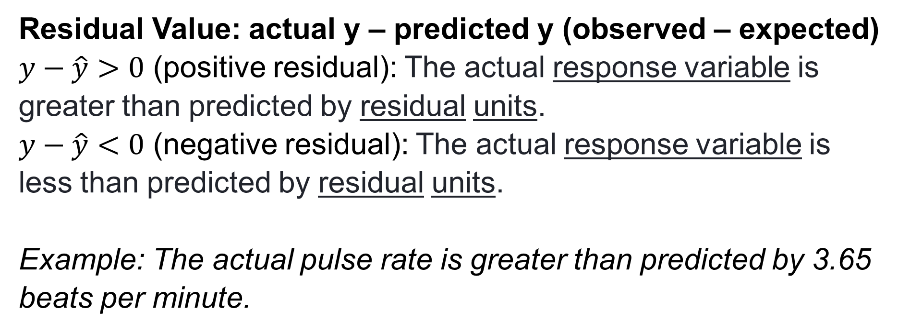
Template
Residual Value: actual y – predicted y (observed – expected)
$y−\hat{y}>0$ (positive residual): The actual response variable is greater than predicted by residual units.
$y−\hat{y}<0$ (negative residual): The actual response variable is less than predicted by residual units.
Example: The actual pulse rate is greater than predicted by 3.65 beats per minute.

Slide 10
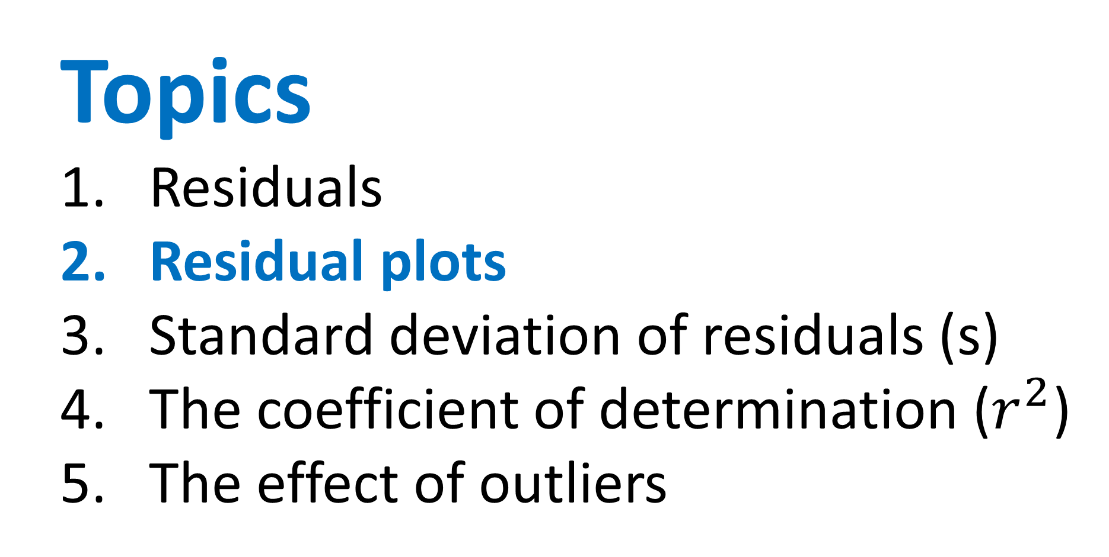
Topics
Residuals
Residual plots
Standard deviation of residuals (s)
The coefficient of determination ($r^{2}$)
The effect of outliers

Slide 11
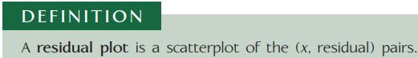
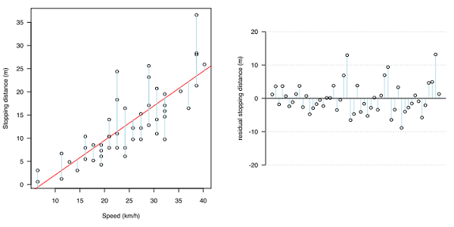
Residual Plots
It allows us to see if there is a pattern within the data that we perhaps could not see on the scatterplot.
If there is no pattern in the residual plot, it means the line captures the overall pattern of the data and that a line is an appropriate model for the data.

Slide 12
Residual Plots – Good Fit
Residuals randomly scattered around 0, without a pattern → linear model is a good fit for this data!

Slide 13
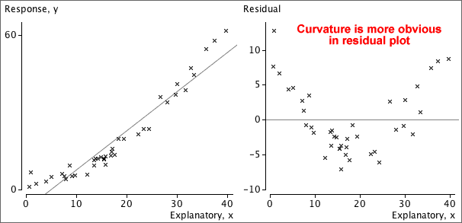
Residual Plots – Non-Linear

Slide 14
Residual Plots – Non-Linear

Slide 15
Residual Plots – Non-Linear
Residuals show a curved pattern→ linear model is not a good fit for this data!

Slide 16
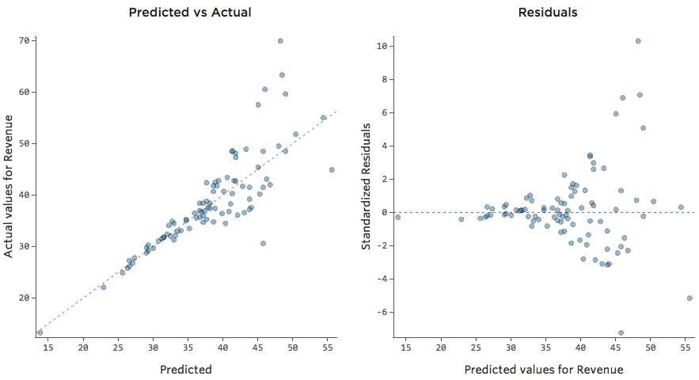
Residual Plots – Heteroskedastic

Slide 17
Residual Plots – Heteroskedastic
x

Slide 18
Residual Plots – Heteroskedastic
x

Slide 19
Residual Plots – Heteroskedastic
x

Slide 20
Residual Plots – Heteroskedastic
x
More variation in residuals as x values increase → linear model is not a good fit for this data!

Slide 21
Residual Plots – Heteroskedastic
Heteroskedasticity
x
More variation in residuals as x values increase → linear model is not a good fit for this data!

Slide 22
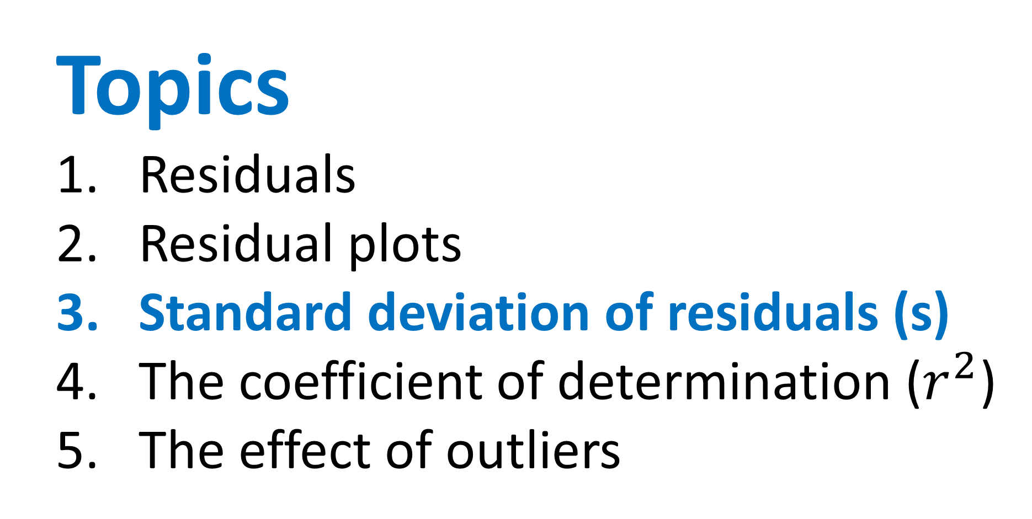
Topics
Residuals
Residual plots
Standard deviation of residuals (s)
The coefficient of determination ($r^{2}$)
The effect of outliers

Slide 23
Standard deviation of the residuals (s)
Standard deviation: Typical distance between data points and the mean
Standard deviation of the residuals (s): Typical error between data points and the LSRL (typical residual length)

Slide 24
Stdev. of the residuals (s)
A
B

Slide 25
Stdev. of the residuals (s)
A
B

Slide 26
Stdev. of the residuals (s)
A
← Stronger relationship between x & y
B

Slide 27
Stdev. of the residuals (s)
A
← Stronger relationship between x & y
Exactly how much stronger is the relationship?
B

Slide 28
Stdev. of the residuals (s)
A
B

Slide 29
Stdev. of the residuals (s)
A
s: The “typical” residual length
B

Slide 30
Stdev. of the residuals (s)
A
s: The “typical” residual length
s:
B

Slide 31
Stdev. of the residuals (s)
A
s: The “typical” residual length
s:
B
s:

Slide 32
Stdev. of the residuals (s)
A
s: The “typical” residual length
Stronger correlation
Smaller s
s:
B
s:

Slide 33
Stdev. of the residuals (s)
A
s: The “typical” residual length
Stronger correlation
Smaller s
s:
B
Weaker correlation
Larger s
s:

Slide 34
1) The standard deviation of the residuals for the LSRL between attendance and test scores is s = 1.99.
Interpret this value.

Slide 35
1) The standard deviation of the residuals for the LSRL between attendance and test scores is s = 1.99.
Interpret this value.
Stem: When using the LSRL with explanatory variable to predict response variable, we will typically be off by about value of s with units of the response variable (y).

Slide 36
1) The standard deviation of the residuals for the LSRL between attendance and test scores is s = 1.99.
Interpret this value.
When using the LSRL with attendance to predict test scores, we will typically be off by about 1.99 points.

Slide 37
1) The standard deviation of the residuals for the LSRL between attendance and test scores is s = 1.99.
Interpret this value.
When using the LSRL with attendance to predict test scores, we will typically be off by about 1.99 points.
Typical residual is about 2 test points.

Slide 38
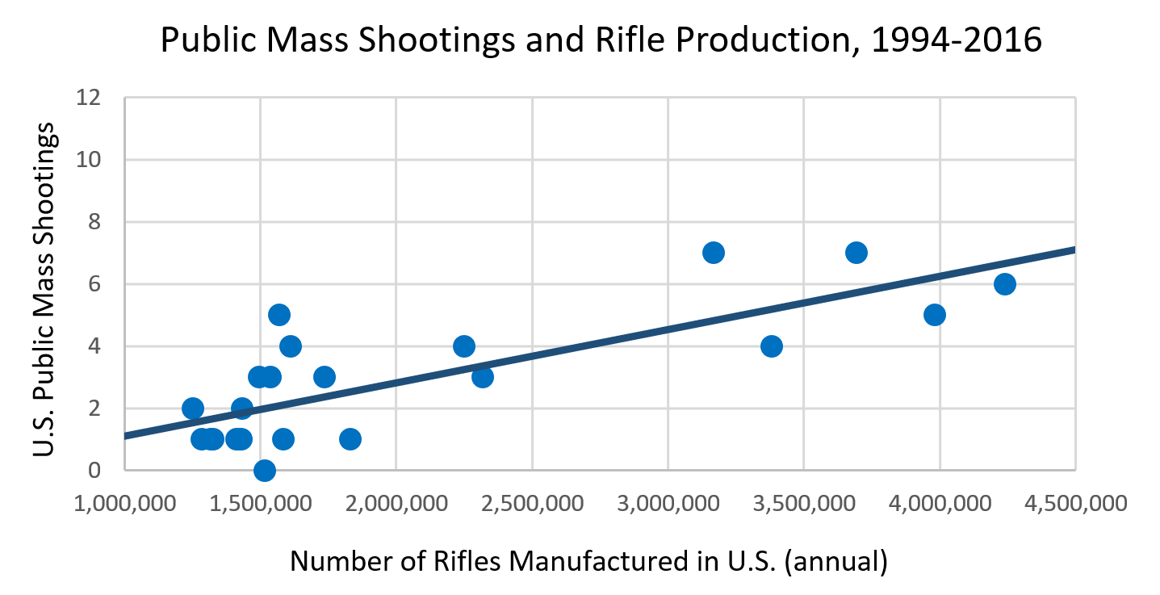

Stdev. of the residuals (s)

Slide 39
Stdev. of the residuals (s)

Slide 40
Stdev. of the residuals (s)
s = 1.31

Slide 41

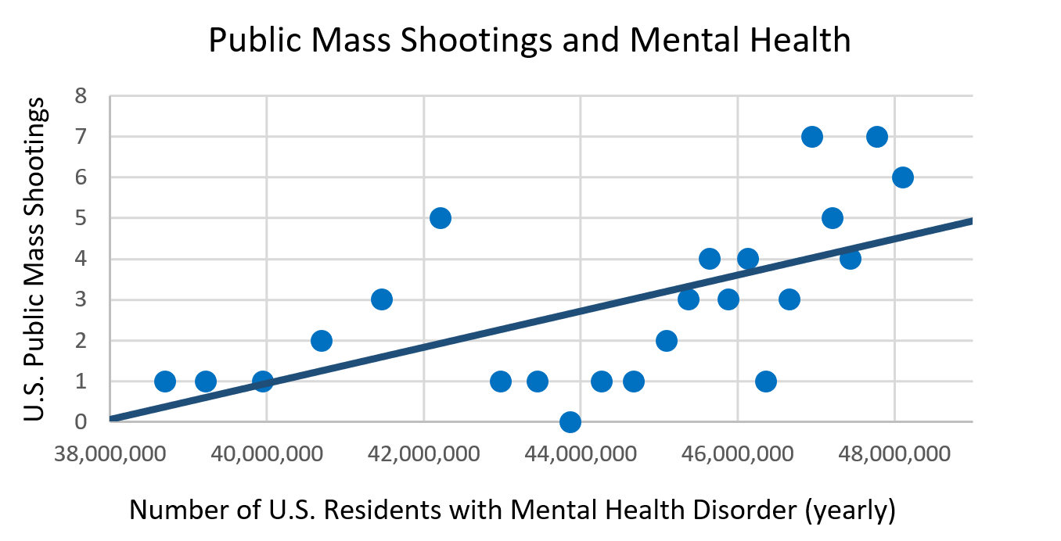
Stdev. of the residuals (s)

Slide 42
Stdev. of the residuals (s)
s = 1.69

Slide 43
Stronger relationship?
Rifle production as explanatory variable:
s = 1.31
Mental health patients as explanatory variable:
s = 1.69

Slide 44
Stronger relationship?
Rifle production as explanatory variable:
s = 1.31 → less prediction error
Mental health patients as explanatory variable:
s = 1.69

Slide 45
Stronger relationship?
Rifle production as explanatory variable:
s = 1.31 → less prediction error
Mental health patients as explanatory variable:
s = 1.69
Rifle production is the stronger predictor of mass shooting frequency

Slide 46
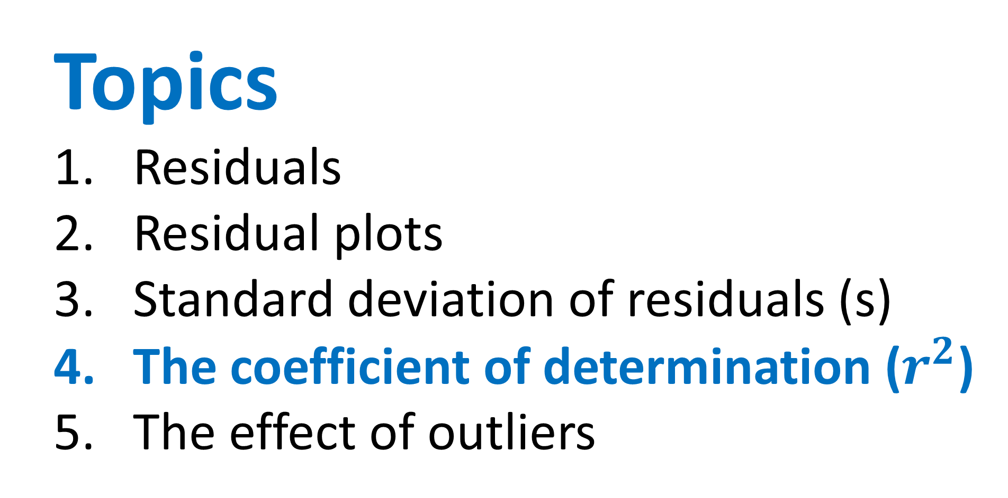
Topics
Residuals
Residual plots
Standard deviation of residuals (s)
The coefficient of determination ($r^{2}$)
The effect of outliers

Slide 47
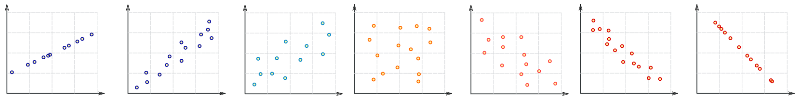
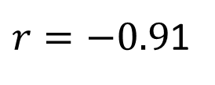
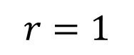
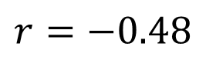
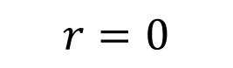
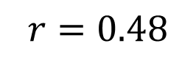
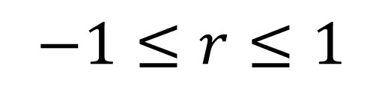
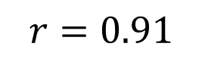
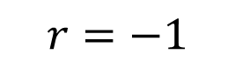
Correlation Coefficient (r)
Graphic inspired by mathisfun.com
Perfect Positive Correlation
Strong Positive Correlation
Weak Positive Correlation
Weak Negative Correlation
Strong Negative Correlation
Perfect Negative Correlation
No
Correlation
$$r=1$$
$$r=0.91$$
$$r=0.48$$
$$r=0$$
$$r=−0.48$$
$r=−0.9$1
$$r=−1$$
$$−1≤r≤1$$

Slide 48
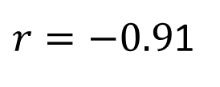
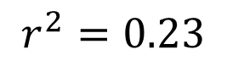
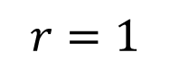
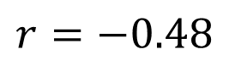
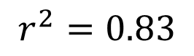
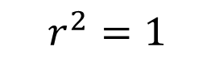
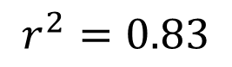
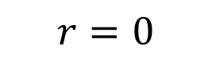
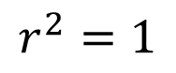
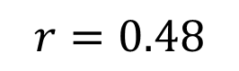
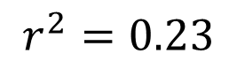

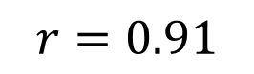
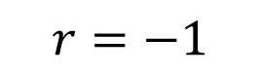
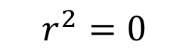
Coefficient of determination (r²)
Graphic inspired by mathisfun.com
Perfect Positive Correlation
Strong Positive Correlation
Weak Positive Correlation
Weak Negative Correlation
Strong Negative Correlation
Perfect Negative Correlation
No
Correlation
$$r=1$$
$$r=0.91$$
$$r=0.48$$
$$r=0$$
$$r=−0.48$$
$r=−0.9$1
$$r=−1$$
$$r^{2}=1$$
$$r^{2}=0.83$$
$$r^{2}=0.23$$
$$r^{2}=0$$
$$r^{2}=0.23$$
$$r^{2}=0.83$$
$$r^{2}=1$$
$$0≤r^{2}≤1$$

Slide 49
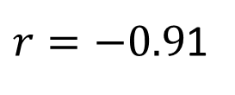
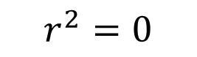
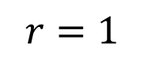
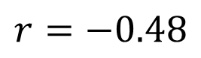
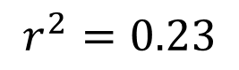
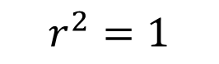
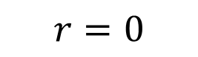
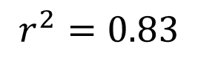






Coefficient of determination (r²)
Graphic inspired by mathisfun.com
Perfect Positive Correlation
Strong Positive Correlation
Weak Positive Correlation
Weak Negative Correlation
Strong Negative Correlation
Perfect Negative Correlation
No
Correlation
$$r=1$$
$$r=0.91$$
$$r=0.48$$
$$r=0$$
$$r=−0.48$$
$r=−0.9$1
$$r=−1$$
$$r^{2}=1$$
$$r^{2}=0.83$$
$$r^{2}=0.23$$
$$r^{2}=0$$
$$r^{2}=0.23$$
$$r^{2}=0.83$$
$$r^{2}=1$$
Squaring the values:
1) Gets rid of negatives
2) Emphasizes differences in strength

Slide 50
Coefficient of determination (r²)
Graphic inspired by mathisfun.com
Perfect Positive Correlation
Strong Positive Correlation
Weak Positive Correlation
Weak Negative Correlation
Strong Negative Correlation
Perfect Negative Correlation
No
Correlation
$$r=1$$
$$r=0.91$$
$$r=0.48$$
$$r=0$$
$$r=−0.48$$
$r=−0.9$1
$$r=−1$$
$$r^{2}=1$$
$$r^{2}=0.83$$
$$r^{2}=0.23$$
$$r^{2}=0$$
$$r^{2}=0.23$$
$$r^{2}=0.83$$
$$r^{2}=1$$
Squaring the values:
1) Gets rid of negatives
2) Emphasizes differences in strength

Slide 51
Coefficient of determination (r²)
Graphic inspired by mathisfun.com
Perfect Positive Correlation
Strong Positive Correlation
Weak Positive Correlation
Weak Negative Correlation
Strong Negative Correlation
Perfect Negative Correlation
No
Correlation
$$r=1$$
$$r=0.91$$
$$r=0.48$$
$$r=0$$
$$r=−0.48$$
$r=−0.9$1
$$r=−1$$
$$r^{2}=1$$
$$r^{2}=0.83$$
$$r^{2}=0.23$$
$$r^{2}=0$$
$$r^{2}=0.23$$
$$r^{2}=0.83$$
$$r^{2}=1$$
Squaring the values:
1) Gets rid of negatives
2) Emphasizes differences in strength

Slide 52

The coefficient of determination ($r^{2}$)
$r^{2}$ close to 0 → weak correlation
$r^{2}$ close to 1 → strong correlation
Interpretation:
$r^{2}$% of the variation in response variable can be explained by the linear relationship with explanatory variable

Slide 53
What percent of the data’s pattern can be explained by a linear model?

Slide 54
What percent of the data’s pattern can be explained by a linear model?

Slide 55

What percent of the data’s pattern can be explained by a linear model?
100%. The linear model completely explains the data’s pattern.
$$r^{2}=1.00=100\%$$

Slide 56
What percent of the data’s pattern can be explained by a linear model?
100%. The linear model completely explains the data’s pattern.
$$r^{2}=1.00=100\%$$

Slide 57

What percent of the data’s pattern can be explained by a linear model?
100%. The linear model completely explains the data’s pattern.
$$r^{2}=1.00=100\%$$
72%. The linear model explains some of the data’s pattern, but not all of it.
$$r^{2}=0.72=72\%$$

Slide 58
1) Interpret: r² = 0.62

Slide 59

1) Interpret: r² = 0.62
$r^{2}$% of the variation in response variable can be explained by the linear relationship with explanatory variable

Slide 60

1) Interpret: r² = 0.62
$62$% of the variation in yearly mass shootings can be explained by the linear relationship with yearly rifle production.

Slide 61


r² = 0.62

Slide 62
r² = 0.62
r² = 0.36

Slide 63
r² = 0.62
r² = 0.36
r² = 0.69

Slide 64

Video game sales were the strongest predictor of the annual frequency of public mass shootings in the United States.
r² = 0.69

Slide 65
Relationship between s and r²
A
B

Slide 66
Relationship between s and r²
A
Strong:
Low s
High r²
B

Slide 67
Relationship between s and r²
A
Strong:
Low s
High r²
Weak:
High s
Low r²
B

Slide 68

Topics
Residuals
Residual plots
Standard deviation of residuals (s)
The coefficient of determination ($r^{2}$)
The effect of outliers

Slide 69
What is an outlier in a regression model?

Slide 70
What is an outlier in a regression model?
Not an outlier! Even though far away from other points, it is still close to our linear model.

Slide 71
What is an outlier in a regression model?
Not an outlier! Even though far away from other points, it is still close to our linear model.
It is an outlier! The point is unusually far from the regression line compared to the other points

Slide 72
What is an outlier in a regression model?

Slide 73
What is an outlier in a regression model?
Not an outlier! Even though far away from the LSRL, it is not unusually far from the LSRL. Most data points vary a lot from the LSRL.

Slide 74
Data from 1994-2016

Slide 75

Data from 1994-2017

Slide 76
Data from 1994-2017
2017

Slide 77
Data from 1994-2017
Outlier
2017
A data value unusually far away from the LSRL (unusually large residual)

Slide 78
Data from 1994-2016
r = 0.79

Slide 79
Data from 1994-2017
r =

Slide 80
Data from 1994-2017
r = 0.67

Slide 81
Data from 1994-2016
r² = 0.62

Slide 82
Data from 1994-2017
r² =

Slide 83
Data from 1994-2017
r² = 0.45

Slide 84
Data from 1994-2016
s = 1.31

Slide 85
Data from 1994-2017
s =

Slide 86
Data from 1994-2017
s = 1.98

Slide 87
r, r², and s are not resistant to outliers.

Slide 88
r, r², and s are not resistant to outliers.
Outliers lower the strength of a relationship, making…

Slide 89
r, r², and s are not resistant to outliers.
Outliers lower the strength of a relationship, making…
r smaller (magnitude)
r² smaller
s larger

Slide 90
Lesson 3.3
Discussion

Slide 91
Video game sales were the strongest predictor of the annual frequency of public mass shootings in the United States.
r² = 0.69

Slide 92
Almost 70% of the variation in yearly public mass shootings can be explained by the linear relationship with video game sales.
r² = 0.69

Slide 93

Position 3
Culture is at fault → violent video games:
“We must stop the glorification of violence in our society…this includes the gruesome and grisly video games that are now commonplace.”
-Donald Trump, 2019

Slide 94
Discussion Question: Would banning violent video games prevent more mass shootings than banning assault weapons or improving mental health services? Why or why not?

Slide 95
Correlation ≠ Causation

Slide 97


Slide 98


Slide 99


Slide 100
Remind you of anything?

Slide 101

Courtesy of Tyler Vigen: https://www.tylervigen.com/spurious-correlations

Slide 102

Courtesy of Tyler Vigen: https://www.tylervigen.com/spurious-correlations

Slide 103

Courtesy of Tyler Vigen: https://www.tylervigen.com/spurious-correlations

Slide 104

Courtesy of Tyler Vigen: https://www.tylervigen.com/spurious-correlations

Slide 105
Just as public mass shootings have risen in the past decade, so have:
Video game sales
People who report a mental health disorder
Sales of firearms

Slide 106
Just as public mass shootings have risen in the past decade, so have:
Video game sales
People who report a mental health disorder
Sales of firearms
The population size of the United States
The average height of the population
So many other things…

Slide 107
Two trends coinciding doesn’t mean they are causally related. There needs to be further evidence to prove a causal connection.

Slide 108
Two trends coinciding doesn’t mean they are causally related. There needs to be further evidence to prove a causal connection.
We’ll learn how to investigate causality later.

Slide 110
BS
(Bad Statistics)

Slide 111
Lesson 3.3
Practice

